Slide 1
AgentScore weekly update
Week of November 9, 2026

Slide 2
One customer is live and most leads do not reply
Status: At Risk. Only Tritusa has used AgentScore, so feedback is thin
Question | Answer
Who is using it | Tritusa live | Wolters Kluwer signed in, nothing run | Tosca agent (ATA) scoring | 13 companies demoed
What stops onboarding | Under 12% of interested leads reached a demo | 94 emailed, no reply | 4 of 13 demos needed on-prem | Group scoring blocks 5 accounts
Feedback from users | Tritusa scored well and asked "now what?" | Top asks: simulation testing (6 accounts), group scoring (5)
What is next | Tritusa session Tuesday, deck update Wednesday | Early-adopter email | Steering committee, week of Nov 16

Slide 3
Six accounts could not onboard without on-prem
Accounts grouped by what is stopping them, as of Nov 10
Where they are | Accounts | What happened
Using it | Tritusa | Live since Oct 22 | Scored well, then asked "now what?" | Wants help on scoring, guardrails (none yet), failures, reports | Run frequency not set or measured
Using it, nothing run | Wolters Kluwer | Signed in Nov 4, has not run anything | Needs group scoring | AI Workspace traces wait on a legal opt-in
No on-prem | Accenture, PG&E, Oracle, Meta, Love's, Eaton | 4 of 13 demos required it (Love's, Meta, Eaton, Accenture) | Accenture and Meta want their own AWS | PG&E and Oracle want their own cloud | Eaton not settled
No group scoring | Wolters Kluwer, Meta, Aptiv, Eaton, Accenture | 5 accounts want to score a group of agents or a workflow
Other missing pieces | Meta, Eaton, L'Oréal, Merito | Meta: simulation testing | Eaton: CI/CD gate, data-handling answer | L'Oréal: AI Workspace opt-in | Merito: partner access
Invited, no sign-in | Merito, L'Oréal, Aptiv, New Vision, Eaton, BearingPoint, Workday | 7 of 9 invited | No reply after follow-up

Slide 4
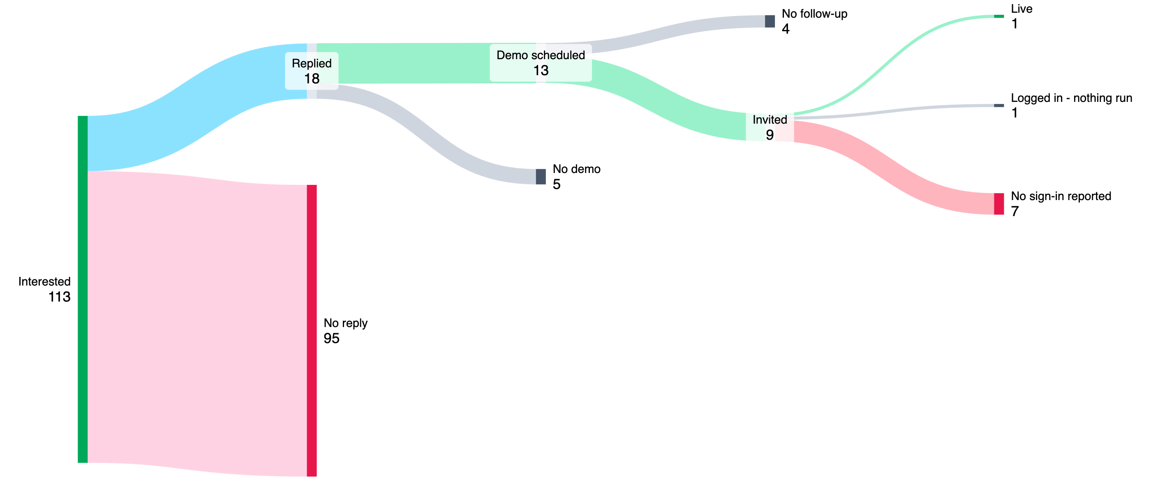
Under 12% of interested leads reached a demo
94
emailed, no reply
14%
of 167 submissions are junk
113 interested companies, 13 reached a scheduled demo (11.5%)
Median 6 days from first email to reply, range 1 to 35
Four replied only after the Sep 24 follow-up, 34 to 35 days later
On-prem is now asked before a demo, so those leads stop at no demo
4 of 13
demos needed on-prem

Slide 5
Of 113 interested, 18 replied and 2 signed in
Days from signup to | Avg | Median | Cos.
First email | 1.5 | 0 | 92
First reply | 14.6 | 7 | 14
Demo | 25 | 18 | 7
Beta invite | 47 | 51 | 8
First sign-in | 72 | 72 | 1
First email goes out in about a day
Replies took a median 7 days from signup, and four waited 35 to 39 days for the Sep 24 follow-up
Demo uses the 7 companies with a recorded date. First sign-in is Tritusa only, by reported date

Slide 6
Signups run about 1 a day without Transform
140 dated form submissions, 55% on the three event days
The other 63 came over 70 days, 0.9 a day. With event days it is 1.9
Transform invites are used up
Next is an early-adopter email through Ryan, to smaller tech, telco and e-commerce companies

Slide 7
The steering committee pitch is the week of Nov 16
THIS WEEK
EARLY ADOPTERS
STEERING COMMITTEE
Tritusa session Tuesday
Deck update Wednesday
On-prem demand counted
Email draft to David
David takes it to Ryan
Optional internal webinar
Half-hour pitch
Milestones and evidence needed
Release: customers love it, plus 6 weeks

